Slide 1

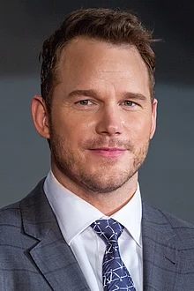

Good Morning
Chris Pratt!!

Slide 2
Good Morning!!

Slide 3
In what do your work?

Slide 4
I am actor of films, voice actor and I represented series.

Slide 5
What is your favorite film that you represented?

Slide 6
Is Guardians of the Galaxy on 2014

Slide 7
How old are you Mr.Pratt?

Slide 8
I am 40 years old

Slide 9
Where do you live when you are a boy?

Slide 10
When I’m a child I lived on Virginia, but when I’m 2 years old I go to live to Hawaii

Slide 11
Why did you go to hawaii to live?

Slide 12
Because I study and I go to work to Hawaii

Slide 13
Ok, thanks.
And when do you start your acting career?

Slide 14
My career starts when I’m 21 years old, on 2000 to the actuality

Slide 15
Where do you live now, in the actuality?

Slide 16
Now I live in a island of Hawaii called Mamui.

Slide 17
Which are the the films that you represented like voice actor?

Slide 18
Are films like Lego the film 1 and 2 and Onward

Slide 19
Why do you are ator?

Slide 20
Because… I worked on a restaurant and Rae Dawn tell me that I can be actor

Slide 21
With who are you married?

Slide 22
With Katherine Schwarzenegger

Slide 23
How many babies do you have?

Slide 24
I have only 1 babie.

Slide 25
Who is your best friend actor?

Slide 26
Is a girl that make with me 2 films Bryce Dallas

Slide 27
When did you got the part of the actor, how did you feel?

Slide 28
I feel so excited because I’m part of the famous actors of the world.

Slide 29
How much trophies had you win?

Slide 30
I win two saturn awards and a star of the hollywood hall of fame

Slide 31
Who are your parents?

Slide 32
They are Kathy Pratt and Daniel Clifton Pratt.

Slide 33
Which is your first film that have you represented?

Slide 34
Is Guardians of the Galaxy of 2014

Slide 35
What projects you have to the future?

Slide 36
I liked to be actor of theater, or series of drama

Slide 37
Okay hear finish the entrevist. I hope that in the future you will continue to shine

Slide 38
I wish the same to you, thank you.

