Slide 1
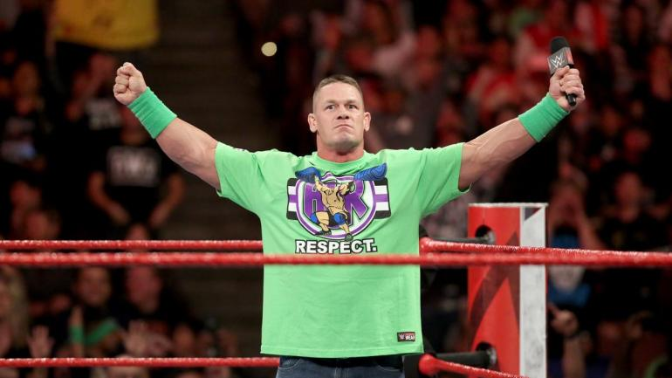
INTERVIEW WITH A STAR CALLED JOHN CENA

Slide 2
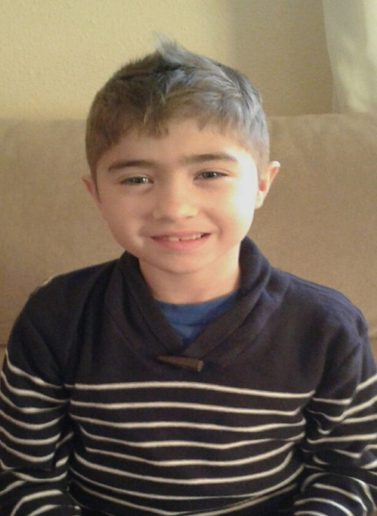
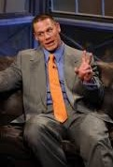
This is my interview with John Cena :
One of the best wrestler of the WWE . He has millions of fans around the world.
I am very happy and super motivated, because I love Spain.
Hello John , how are you?

Slide 3
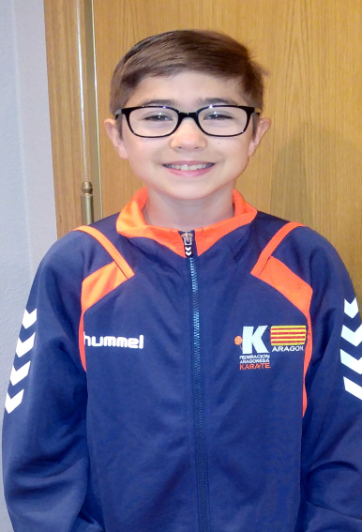
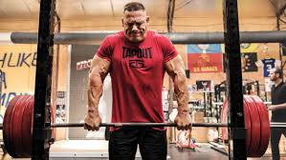
Why did you enter in WWE?
I entered in WWE because there are two things : show and wrestling and I like both things
How long do you train daily?
I train every day 6 or 7 hours.
Which is your lucky charm; ribbon or wristguard?
Oh yes ... I have a lucky charm that I always carry with me. It is a ribbon on my left arm that my grandmother gave me.
When did you become famous?
I became famous when I got my first belt as champion

Slide 4
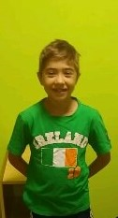
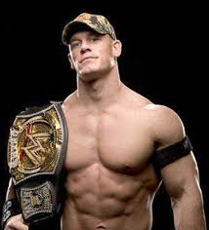
I had my first price in London, I remember its as a the best on my life.
Where did you have your first price?
Which was your best show; Seen or Rock?
My best show was me VS The Rock
Who is your stronger rival?
Who is your best friend in the ring?
My best friend in the ring is The Rock, he is humble and generous.
My stronger rival is Roman Range. He is very ambitious.

Slide 5
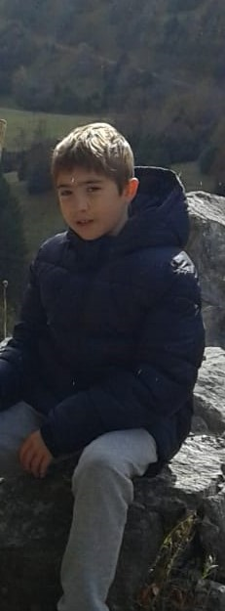
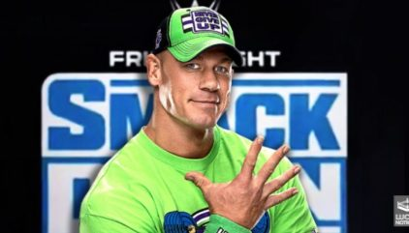
My number one fan is my mother. She loves me.
What is your number one fan?
Why do childrens admire you so much?
Because I had a sentence : (wacha wacha)
How many years do you think to continue in wrestling?
What is your weakness?
My weakness is in my back, because I had a hurt
I think 4-5 years in wrestling

Slide 6
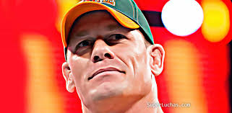
I started in 20-07-1957, I was very young.
Which was your favourite moment-your first champion or first prize?
When did you start the wrestling?
When I won my first belt
Who did choose your presentation sang in your shows?
Why do you like the wrestling?
Because it is competitive and I like the sport. In the wrestling there are both.
I chose my song. I though in a funny song.

Slide 7

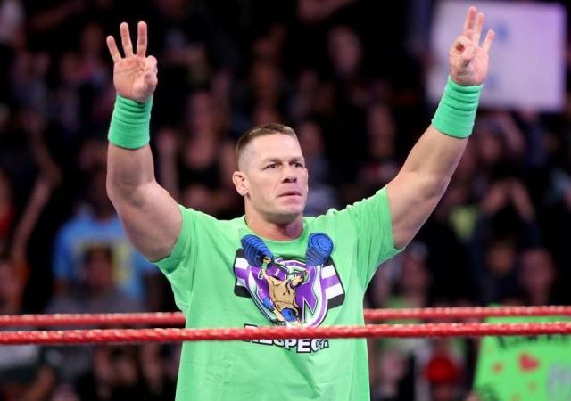
I train in EE.UU in a location called fighters paradise
Where you felt better rapping or fighting?
Where did you train?
I felt better rapping, because it isn’t aggressibe
What wish would you like to ask?
When do you are going to came at Spain?
In one year I will came to Spain
I wish the Coronavirus die and all the person that aren’t here revive

Slide 8
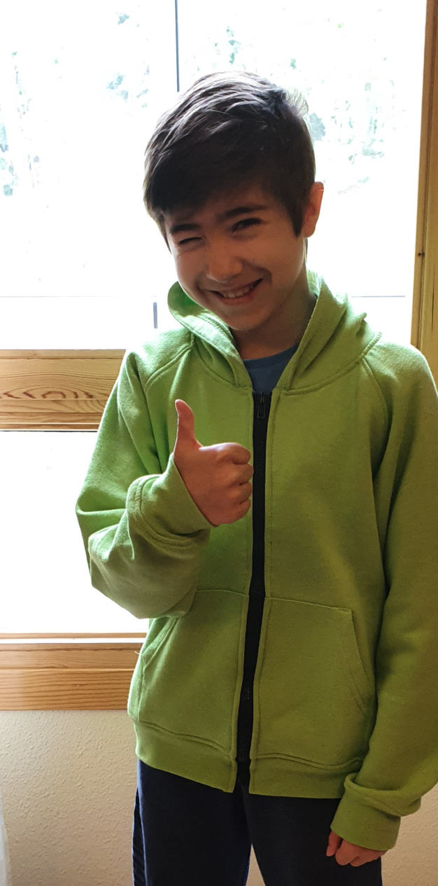
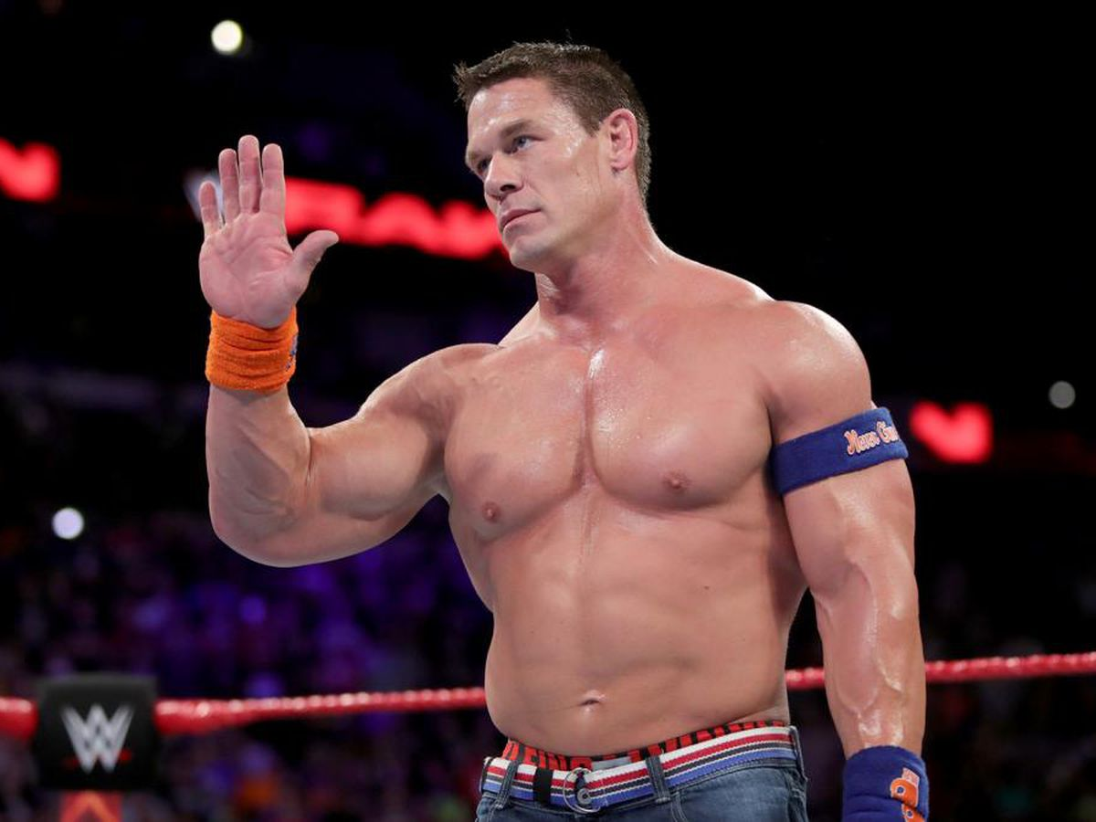
This is the end of the interview
Thanks John good luck

