Slide 1
Interview with Penelope Cruz
By Lara Tolmos

Slide 2
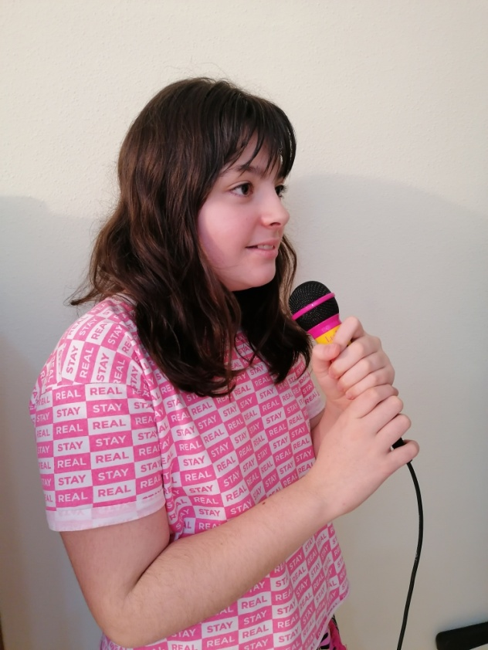
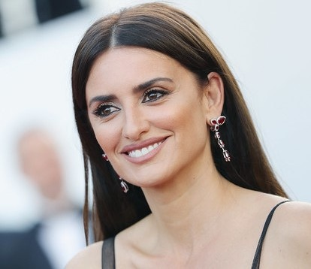
Hello, what is your name?
Hello, my name is Penelope Cruz.

Slide 3
Why did your parents name you Penelope?
Penelope's name is from a song by Joan Manuel Serrat.

Slide 4
How old are you?
I am 46 years old.

Slide 5
Where did you get married?
I married Javier on a private Johnny Depp island in the Bahamas.

Slide 6
Why did you get married there?
Because Johnny is a very good friend of ours and we really liked that place.

Slide 7
Where do you live?
I live in Madrid, in the Salamanca district.

Slide 8
Who is your best friend?
My best friend is Salma Hayek.

Slide 9
What is your favorite food?
My favorite food is cannelloni.

Slide 10
What is your profession?
My profession is actress.

Slide 11
Who is your favorite actor?
My favorite actor is Javier Bardem. He's my husband! hahahahaha

Slide 12
Why did you want to be an actress?
Because I have always liked movies and theater.

Slide 13
Which are your favorite movies?
My favorite movies are: Jamon, Jamon, Belle Epoque, Todo sobre mi madre, Piratas del Caribe…

Slide 14
When did you start your acting career?
I started at 15 years old.

Slide 15
Where did you shoot the movie Jamon Jamon?
We shot that movie at Los Monegros in Zaragoza. It was fun!

Slide 16
Who was the director of the movie Jamon Jamon?
The director was Bigas Luna.

Slide 17
How many Goya awards have you won?
I have won 2 awards for the best leading actress and 1 for the best supporting actress, in total 3 Goya awards.

Slide 18
How was the experience of winning an Oscar?
Winning an Oscar is something very special to me, it is the award for my work.

Slide 19
When did you win your first prize?
In 1998, with the movie “The Girl in Your Eyes”.

Slide 20
Which are the prizes you have won?
I have Oscar Awards, Bafta Awards, Goya Awards and Cesar Awards.

Slide 21
Which are your most famous movies?
My most famous movies are “Jamon Jamon”, “La niña de tus ojos”, “The Good Night”, Volver…
I have so much…

Slide 22
When you went to Hollywood?
After the success of the movie "All about my mother".

Slide 23
Thank you very much Penelope for answering all my questions.
You're welcome, it has been a pleasure.

