Slide 1
INTERVIEW TO LUIS DOMINGUEZ
LUIS DOMINGUEZ IS A SWIMMER

Slide 2
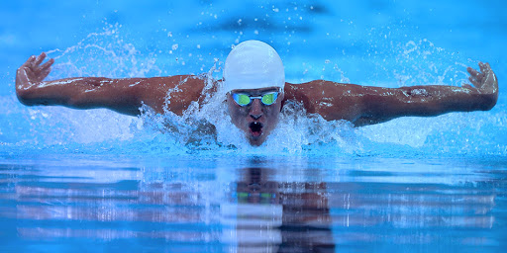
WHAT IS HIS FAVOURITE STYLE ?
HIS FAVOURITE STYLE IS BUTTERFLY

Slide 3
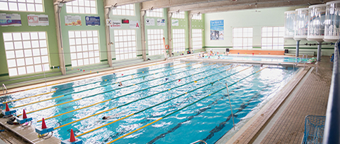
WHERE DOES HE SWIM ?
HE SWIMS IN AN STADIUM CALLED EL OLIVAR

Slide 4
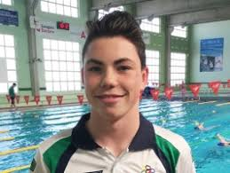
WHEN DID HE START SWIMMING ?
HE STARTED SWIMMING WHEN HE WAS 3 YEARS OLD

Slide 5
WHO CONVINCED HIM TO SWIM ?
HE LIKED SO MUCH SWIMMING SO HE DIDN´T HAVE TO CONVINCED HE

Slide 6
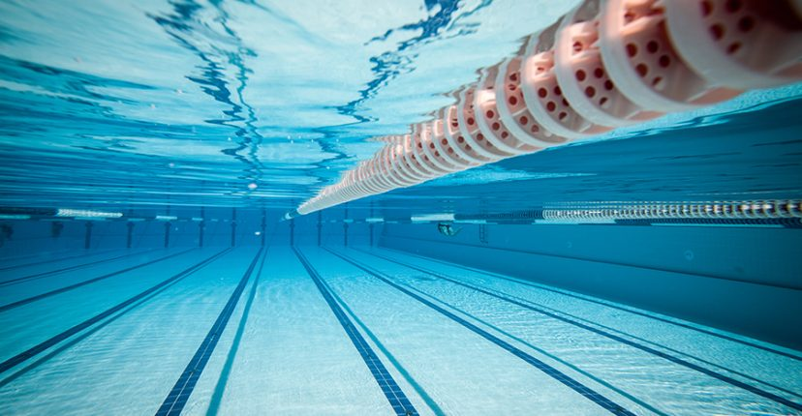
WHY DOES HE LIKE SWIMMING ?
HE LIKES SWIMMING BECAUSE HE LIKES TO DO SPORT AND SWIMMING IS HIS FAVOURITE SPORT

Slide 7
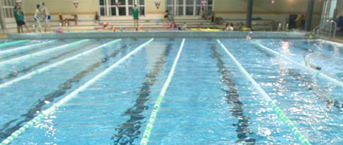
WHICH IS HIS FAVOURITE CLUB ?
HIS FAVORITE CLUB IS EL OLIVAR

Slide 8


HOW DOES HE FEEL WHEN HE IS SWIMMING ON A COMPETITION ?
HE FEELS GOOD AND A LITTLE NERVOUS

Slide 9

WHAT IS HE GOING TO STUDY ?
HE DOESN´T KNOW YET

Slide 10
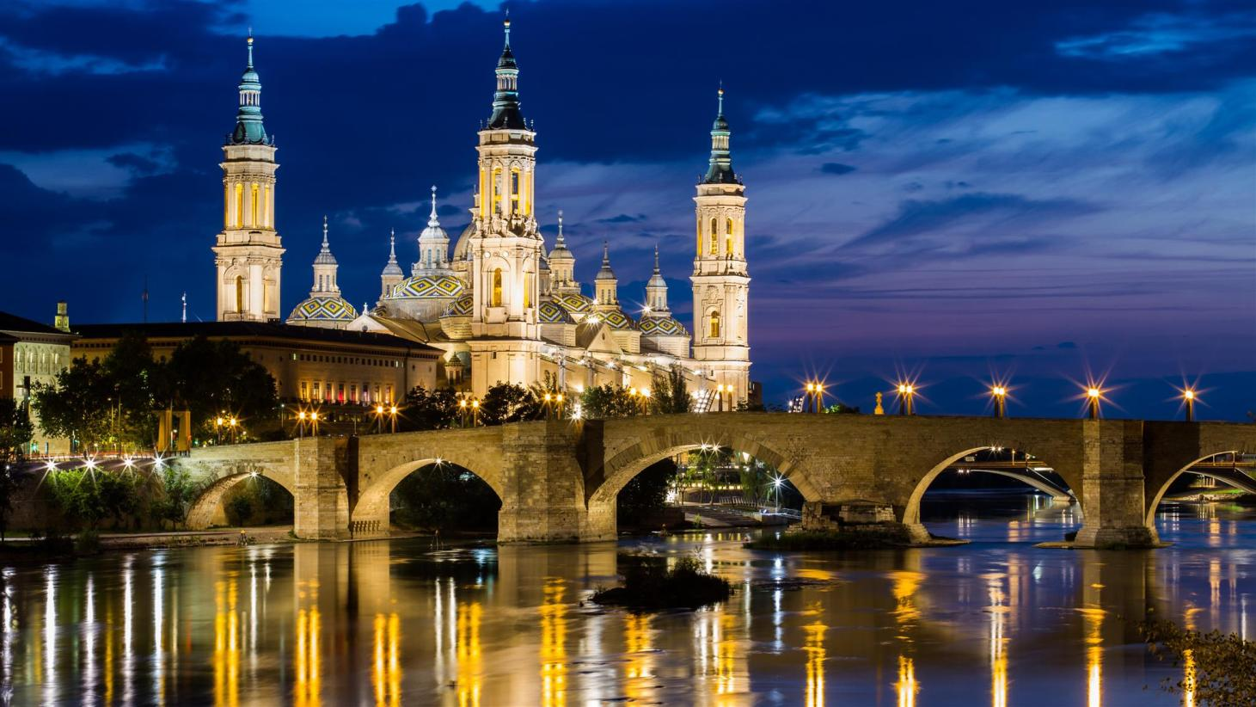
WHERE DOES HE LIVE ?
HE LIVES IN ZARAGOZA

Slide 11

WHEN IS HE GOING TO GO TO THE OLYMPICS ?
HE IS GOING TO GO ON 2024

Slide 12

WHY DOES HE WIN ALL COMPETITIONS ?
BECAUSE HE SAID “LUIS YOU CAN WIN , YOU ARE VERY STRONG ,YOU CAN ’’ AND HE TURNS IN HIM ¡ AND HE DOES IT !

Slide 13
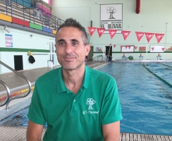
WHICH COACH DOES HE PREFER ?
HE PREFERS A COACH CALLED FERNANDO ALÁEZ

Slide 14

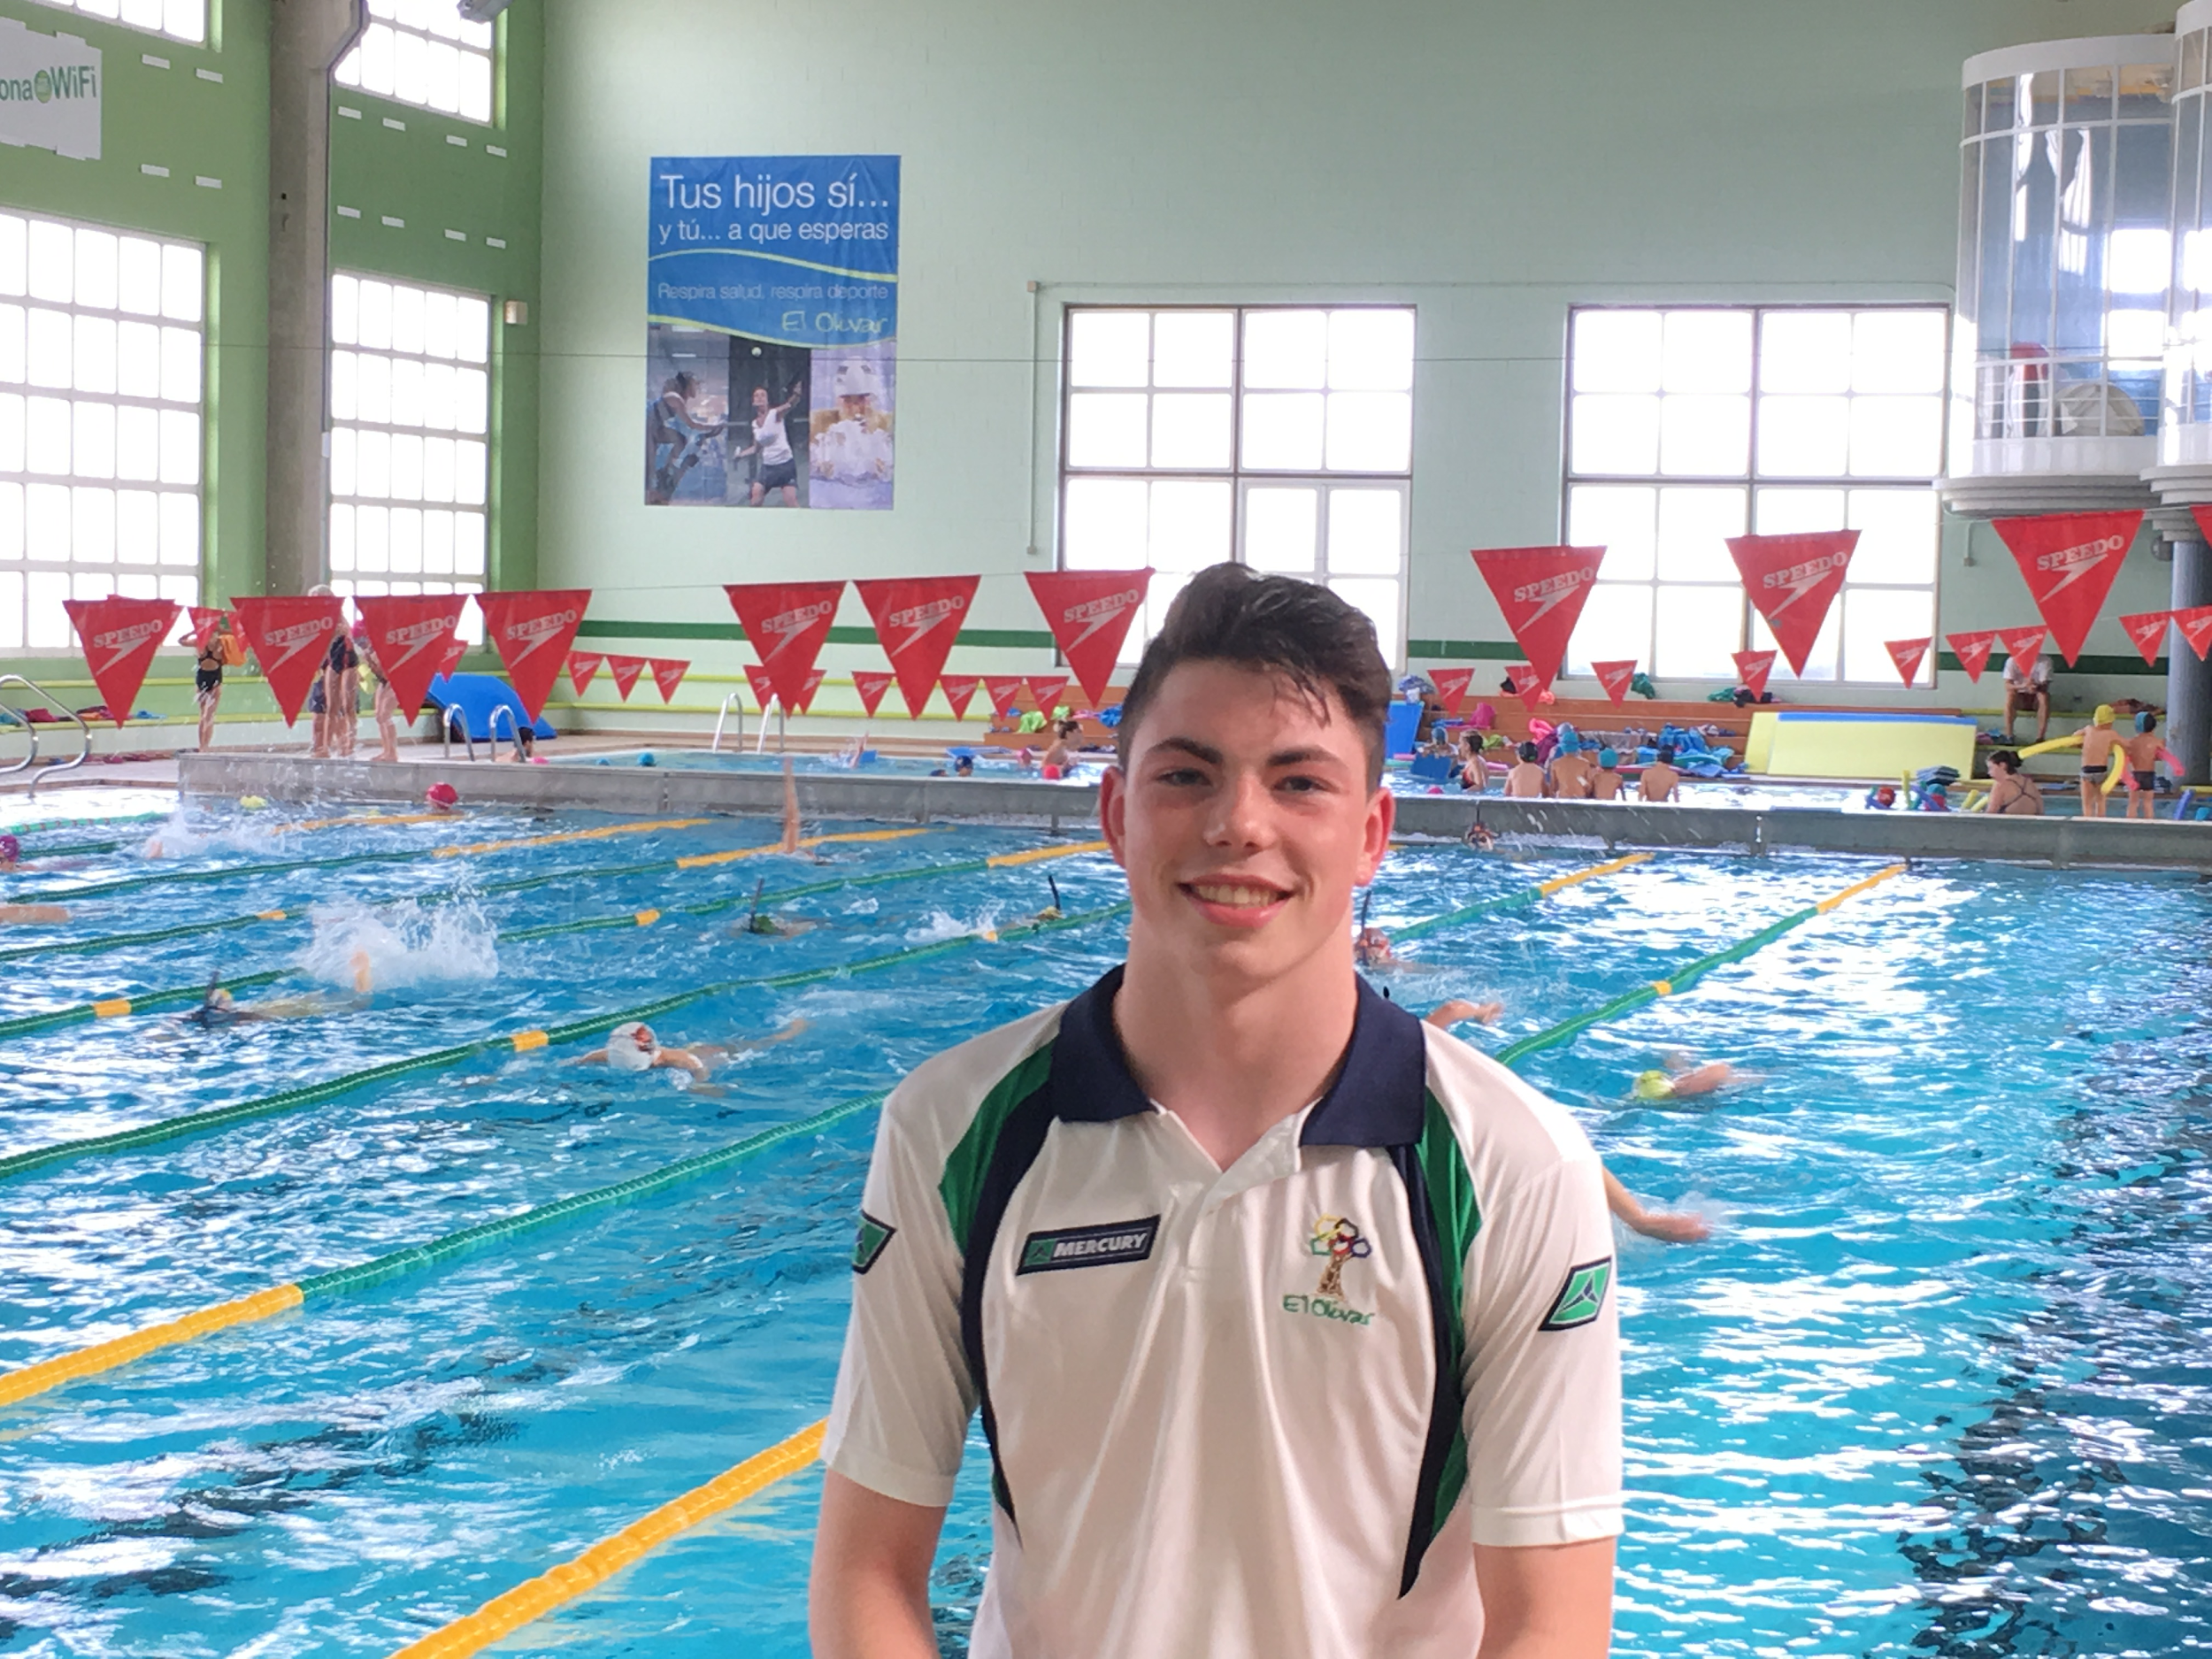
HOW DOES HE FEEL WITH MANY MEDALS ?
HE FEELS SO PROUD OF HIMSELF

Slide 15
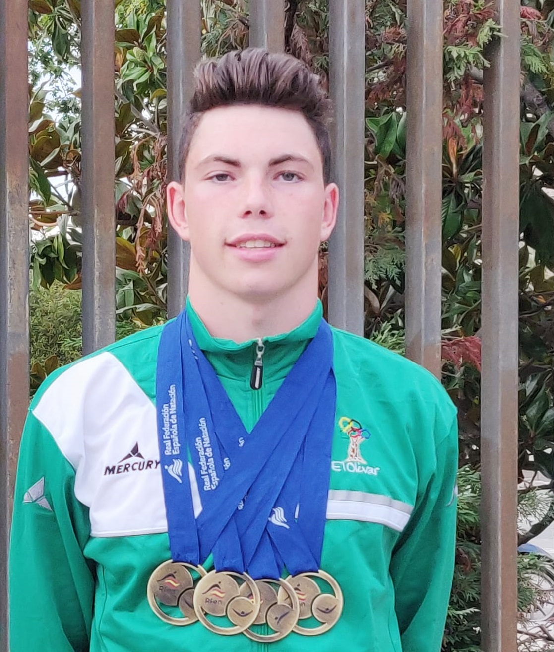
HOW OLD IS LUIS ?
HE IS 17 YEARS OLD

