Slide 1
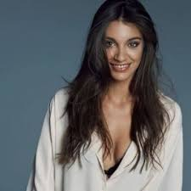
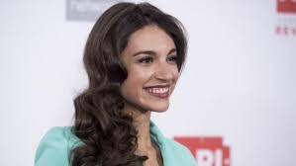
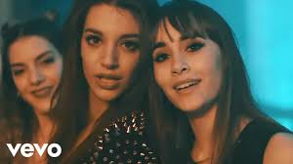
ANA GUERRA

Slide 2
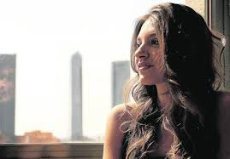
Genoveva: How did you start to like music?
Ana: When I was a child I love the music and I listened to my parents and brothers singing.

Slide 3
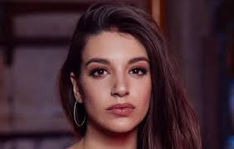
Genoveva: How, did you decided to introduce to “Operación Triunfo”?
Ana: Well, I decided one day when I was 15 years old I looked to the TV and I saw a commercial that talks about an academy in which all the people that wanted could present to the academy and that seemed spectacular to my and from that day I knew I was going to the academy.

Slide 4
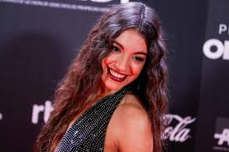
Genoveva: How did you feel when they told you that you had been accepted in the “Operación Triunfo” academy?
Ana: I feel very excited and very happy.

Slide 5
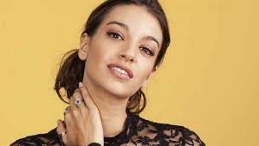
Genoveva: When did you decide to dedicate yourself to the world of music?
Ana: I decided when I knew that I have future in the world of the music.

Slide 6
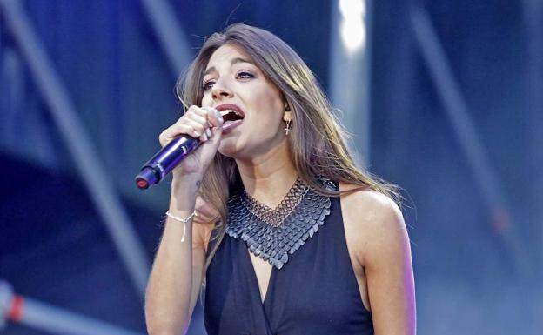
Genoveva: When you were little did you also like music as much as now?
Ana: Well, I love singing and also I love dancing at the same time, but I love more music now that when I was a child.

Slide 7
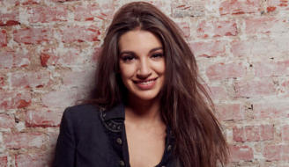
Genoveva: When you where a child did your parents see potential in you?
Ana: My parents told me all the time that I had future in the world of the music, but I don’t believe them. But now I know that my parents had all the reason.

Slide 8
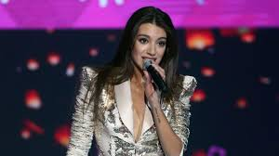
Genoveva: Which was your objective when you where in the academy?
Ana: I don’t had an objective in the academy.

Slide 9
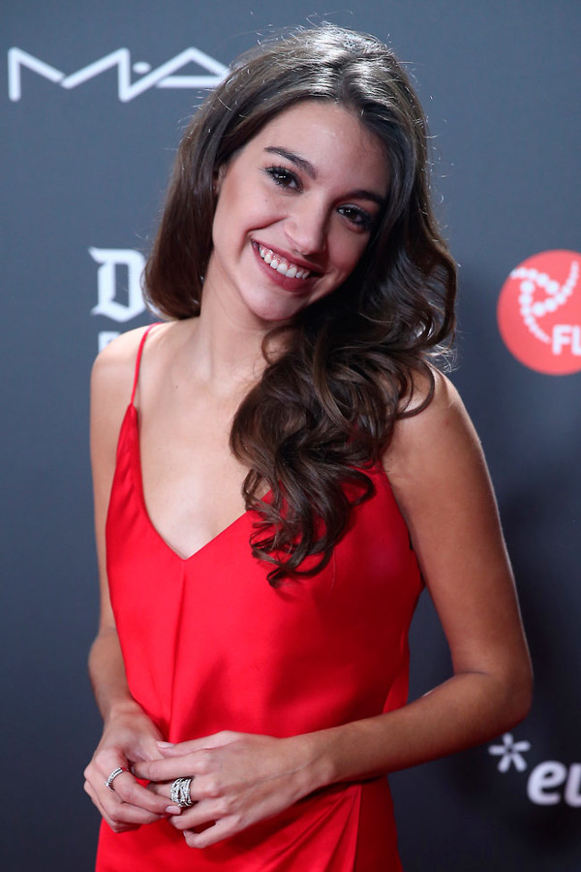
Genoveva: Which was your best moment in your musical career? And your worst moment?
Ana: Well, I don’t had best moment and worst moment but i think that my best moment was when they told me that i was accepted in the academy. And my worst moment was when I went away of the academy.

Slide 10
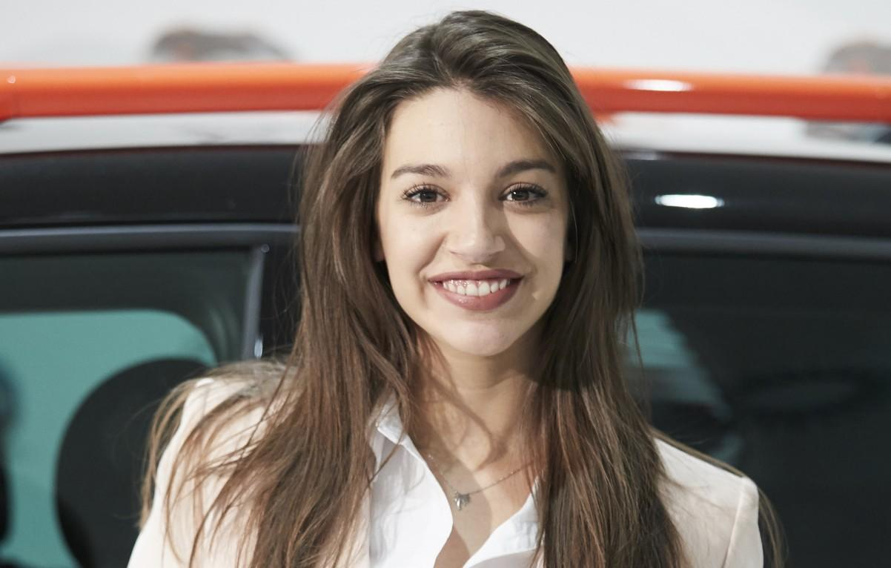
Genoveva: Could you tell me which was your reaction when you know that you had been admitted in the academy?
Ana: My reaction was that when I knew that the first thing I did was that I started to jump and shout a lot.

Slide 11
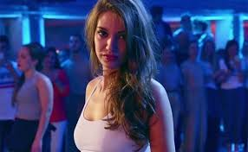
Genoveva: Why you dedicate to the world music?
Ana: Well, I dedicate to the world of the music because I love the music. And music is all for me.

Slide 12
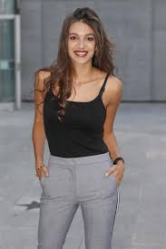
Genoveva: Why do you like music?
Ana: I like music because I love all the things hata form music.

Slide 13
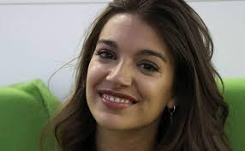
Genoveva: Why don’t you have any family member who is dedicated to music?
Ana: I think that I don’t have a familiar that dedicated to music is because to any of my family like a lot of music.

Slide 14
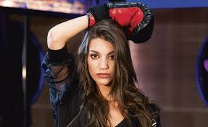
Genoveva: Who convinced to start singing and dancing?
Ana: My parents convinced to me when they told that I had potencial.

Slide 15
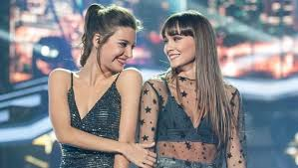
Genoveva: Who help you to compose your songs?
Ana: That depends on everything.

Slide 16
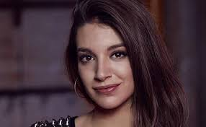
Genoveva: Who support you in your bad moments?
Ana: In my bad moments all my family give me support.

Slide 17
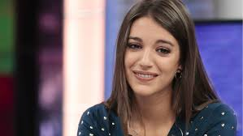
Genoveva: What did your family tell to you when they know that you were accepted in the academy?
Ana: They told me that they are very proud of me.

Slide 18
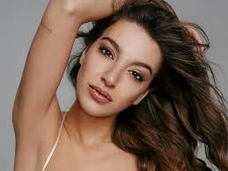
Genoveva: When you were discouraged, what do you tell to yourself to cheer you up?
Ana: I thought in my family and very good things.

Slide 19
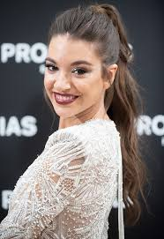
Genoveva: What is the thing you like more in this world?
Ana: Te thing that I like more in this world is do things with my family.

Slide 20
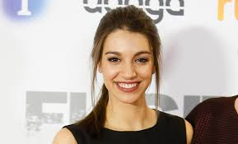
Genoveva: Where do you live?
Ana: I lived in Canarias.

Slide 21
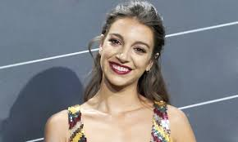
Genoveva: Where do you grew up?
Ana: I grew up in a litte village of Canarias.

Slide 22
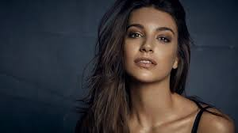
Genoveva: Where live your parents and your family?
Ana: My family and parents live in Andalucía.

Slide 23
THE END

