Slide 1

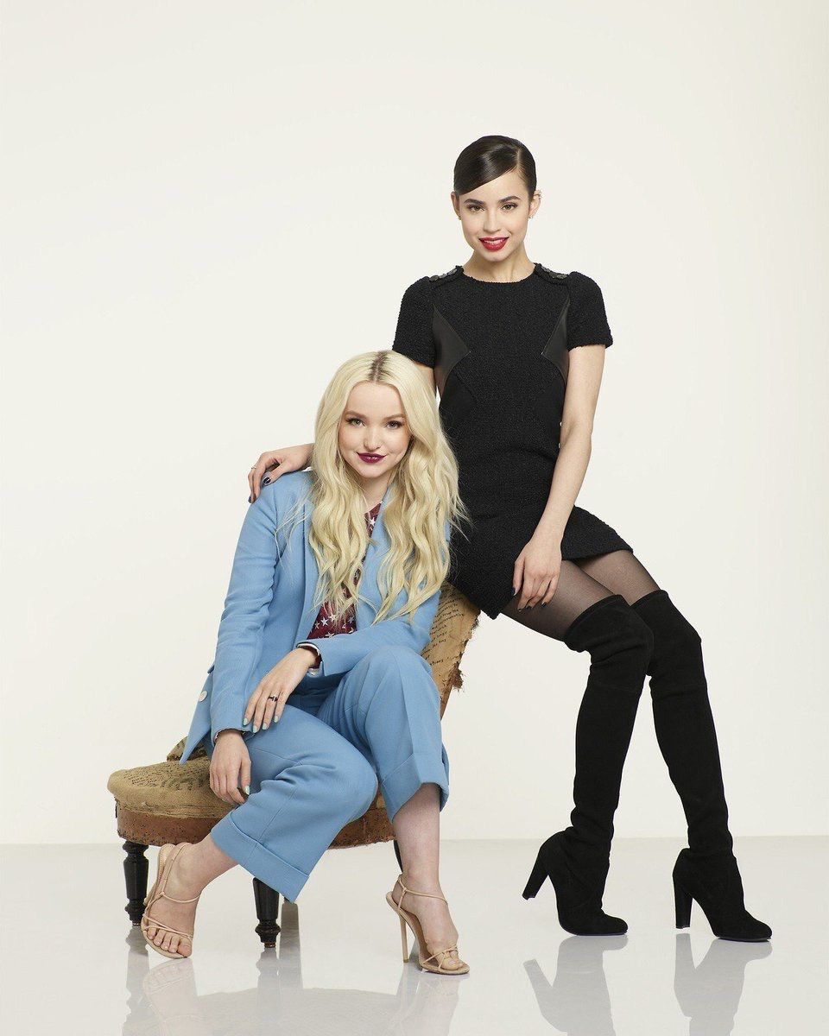
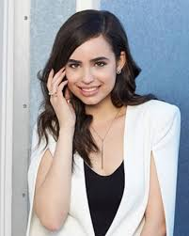
SOFIA CARSON:

Slide 2
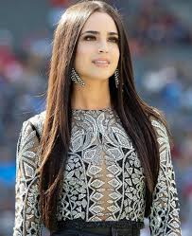
INTRODUCTION
Interviewer - Hello Sofia, today we are going to talk with you and ask you some questions about your film career and also about your personal life. All right, are you ready?
Sofia - Okay, let’s go for it.

Slide 3
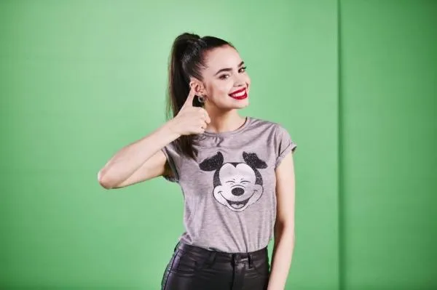
Interviewer - When did you decide you wanted to be an actress?
Sofia- Since I was little, I loved singing and dancing and when I grew up a little bit and realized that I could combine it with acting, I knew that it was my dream.

Slide 4
Interviewer- Why did you decide to become an actress?
Sofia- I decided to become an actress because it was my way of expressing myself and isolating myself from the real life when I need it.

Slide 5
Interviewer- How did you get started performing movies and series?
Sofia- Disney Channel talked to me to perform a small role and since that moment I started doing more and more movies and series.

Slide 6
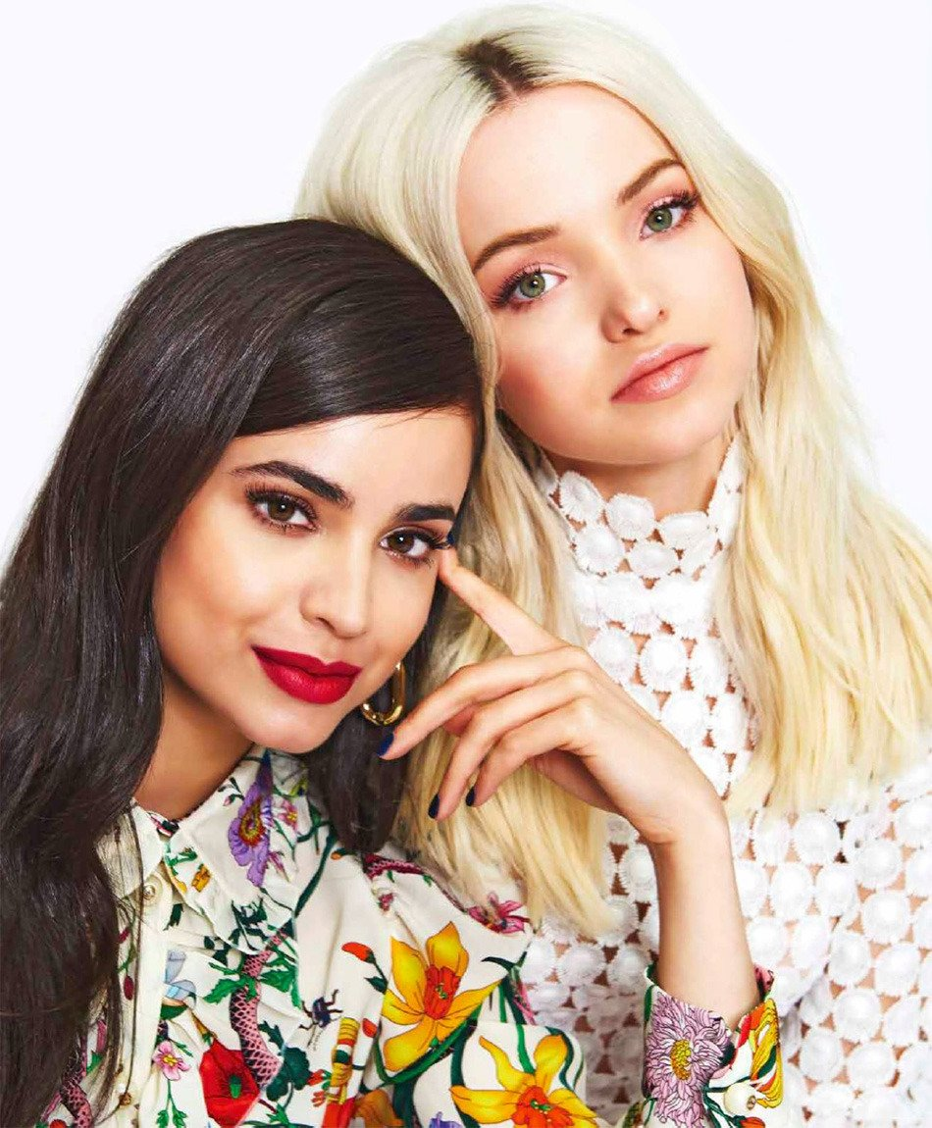
Interviewer- Where did you recorded your first movie or serie?
Sofia- Well, in the first serie I recorded was the serie “Austin and Ally” And the first movie was “Descendants”

Slide 7
Interviewer- How did you feel in the first movie you filmed?
Sofia- I was very excited but also a little bit afraid and nervous. But when we started filming the director and the other actors made my job very easy that all the nerves went out.

Slide 8
Interviewer- Which is your favourite movie or series you have recorded?
Sofia- Of Course, my favourite movies were Descendants ones, because I met really good friends and because the story of the movie is amazing.

Slide 9
Interviewer- Where was the most beautiful place in which you have filmed a movie?
Sofia- Almost all of the places where we filmed Descendants movie, but if I have to choose one, the castle of the last scene of the first Descendants movie was amazing and my favourite.

Slide 10
Interviewer- Between the characters you performed, who was your favourite?
Sofia- So, continuing with Descendants movie performing Evie’s character was an incredible experience but it was also very difficult but satisfactory. Without any doubt, it was my favourite character I had perform.

Slide 11
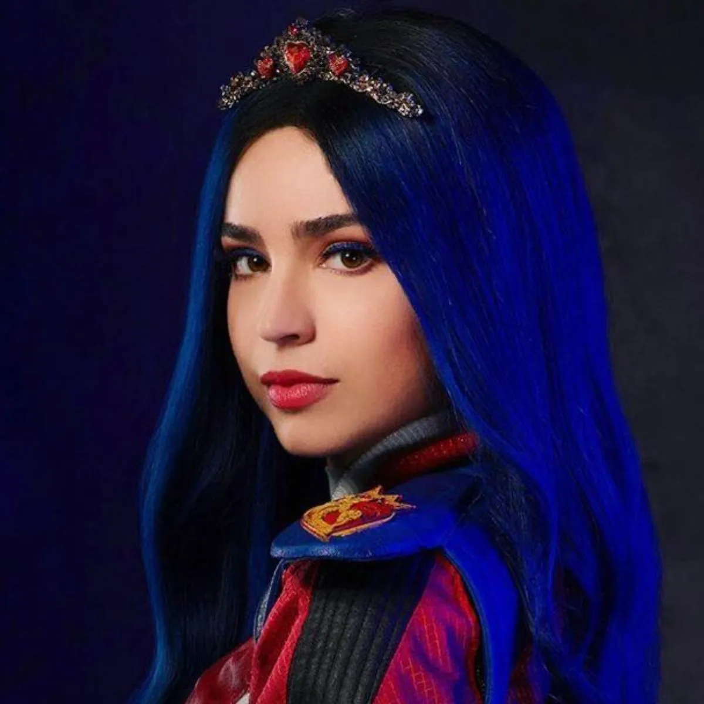
Interviewer- Which was the most difficult dialogue to learn?
Sofia- Since my first serie I had a great facility for learning the dialogues of the movies and series and this never was a problem for me, so I don’t know which was the most difficult dialog for learn.

Slide 12
Interviewer- What do you do when you finish filming a movie?
Sofia- When we finished the last scene all the time claps and not that evening but the following we went to a restaurant and we danced and had a great time for celebrating the movie.

Slide 13
Interviewer- Where do you practice all the dances of the musicals you have performed?
Sofia- First, we meet choreographer individually so everyone can learn perfectly the choreography. Then we practice again with the choreographer but all together. And finally before filming we practice again with the choreographer in the place we are going to film until the choreographer said that is perfect.

Slide 14
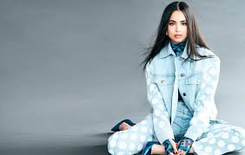
Interviewer- With which actress would you like to to act?
Sofia- Ufffffff… I don’t know exactly, but I would like to act with Angelina Jolie or Keira Knightley maybe… I don’t know but I just want to continue doing movies.

Slide 15
Interviewer- When did you noticed that you were becoming such an important actress?
Sofia- When people started to stop me on the street to ask me for photos, autographs...

Slide 16
Interviewer- Which is your favourite part of 3 Descendants movie?
Sofia- My favourite part of Descendants 3 is when in the movie Mal gives the prince the spelled cookies, that would be my favourite moment on the movie.

Slide 17
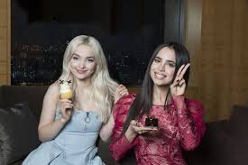
Interviewer- Why did the director of Descendants movie change your character after a few months?
Sofia- I think he changed the roles because I was better at playing Evie and Sarah was better at Audrey.

Slide 18
Interviewer- When have you filmed your last movie or serie?
Sofia- The last movie I made was Descendants 3.

Slide 19

Interviewer- And now some personal questions.

Slide 20
Interviewer- Who inspired you when you were young?
Sofia- I was inspired by all the people who liked to sing and dance like me.

Slide 21
Interviewer- Who is the most important person in your life?
Sofia- The most important person in my life is my mother and my father.

Slide 22
Interviewer- And why is your mother and your father the most important person in your life?
Sofia- Because they are my parents and also because they have also been protecting and helping me.

Slide 23
Interviewer- How did you react to the death of your friend Cameron Boyce?
Sofia- Well, like all his friends we were very sad because he was a very good person and also a very special person...

Slide 24

Interviewer- Thanks Sofia for your sincerity, and now we said goodbye to the star Sofia Carson!!!!!!!!

