Slide 1

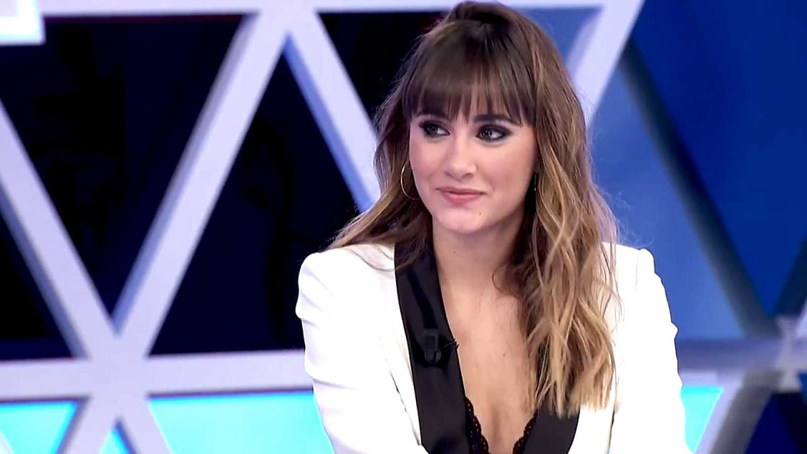
Interview with a star
Aitana
By Ana Lahuerta

Slide 2

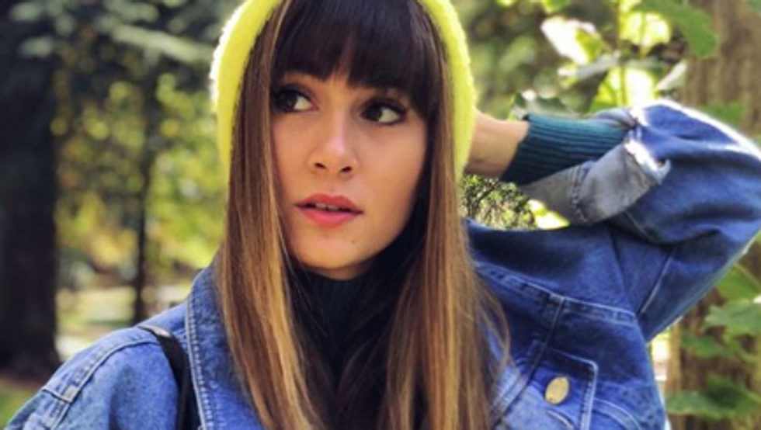
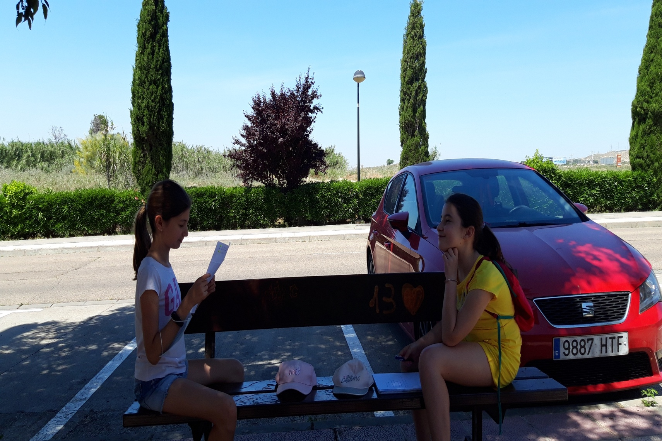
Question: Who was the first person that said you that you sing very well?
Answere: My father

Slide 3

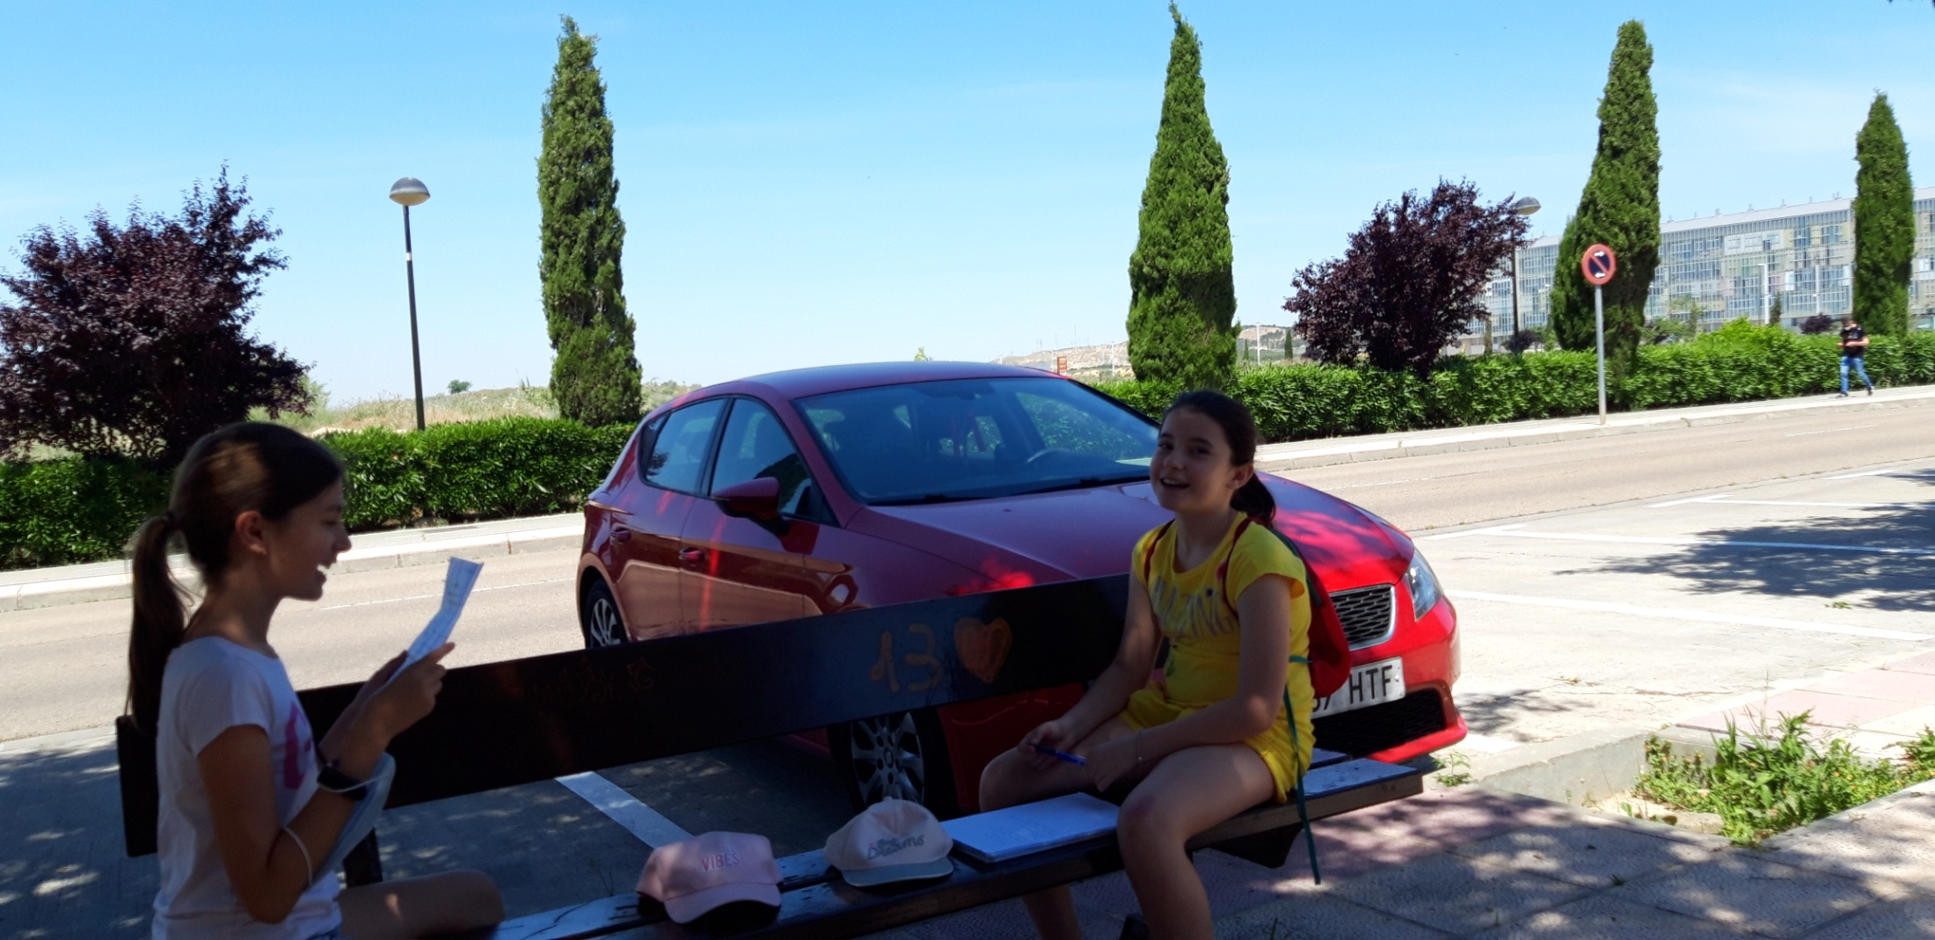
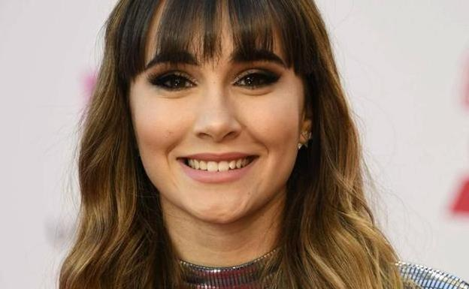

Slide 4
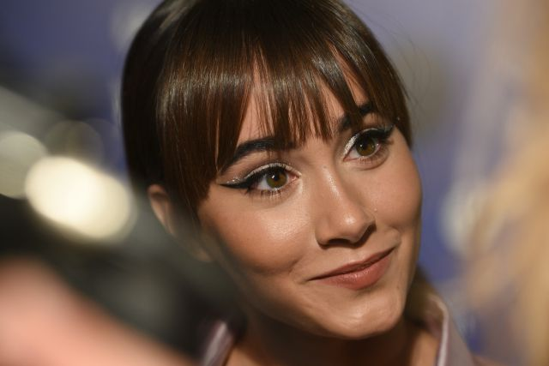

Slide 5
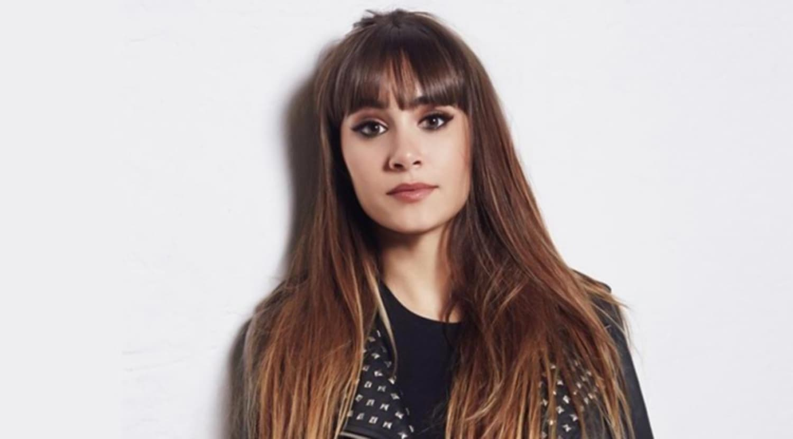
Question: when your next song comes out?
Answere: I don’t now exactly the day but I’m sure that in June

Slide 6
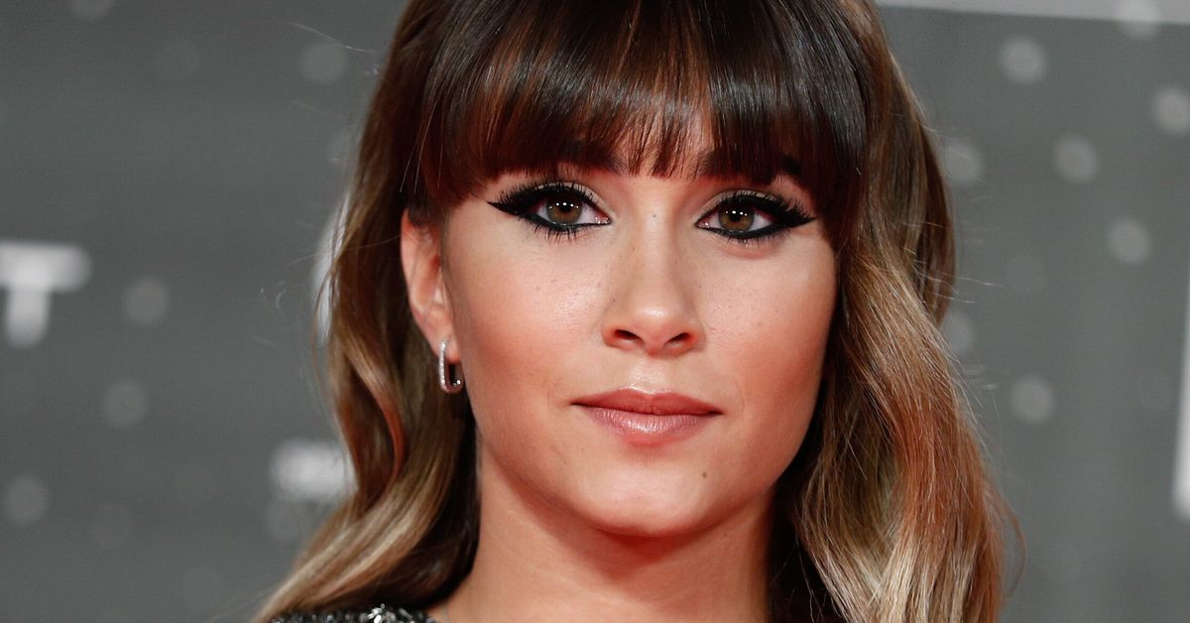
Question: What kind of voice do you have?
Answere: I have a Soprano voice

Slide 7
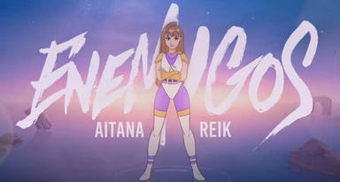

Slide 8

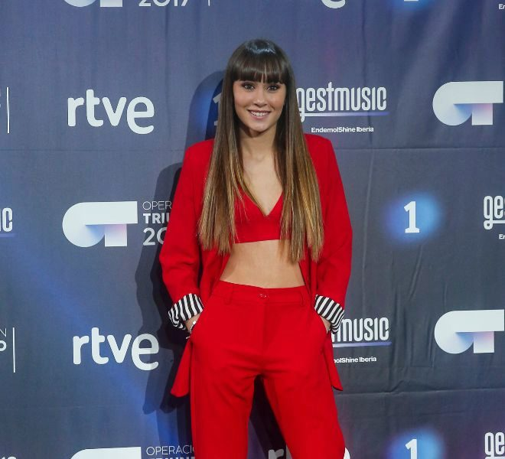

Slide 9
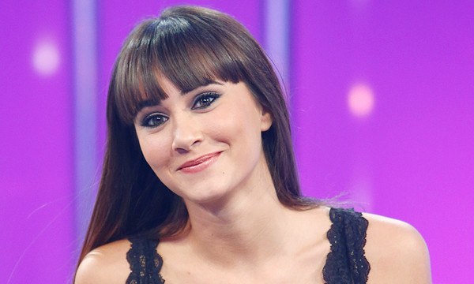
Question: when were you born?
answere: In the 27th of June

Slide 10
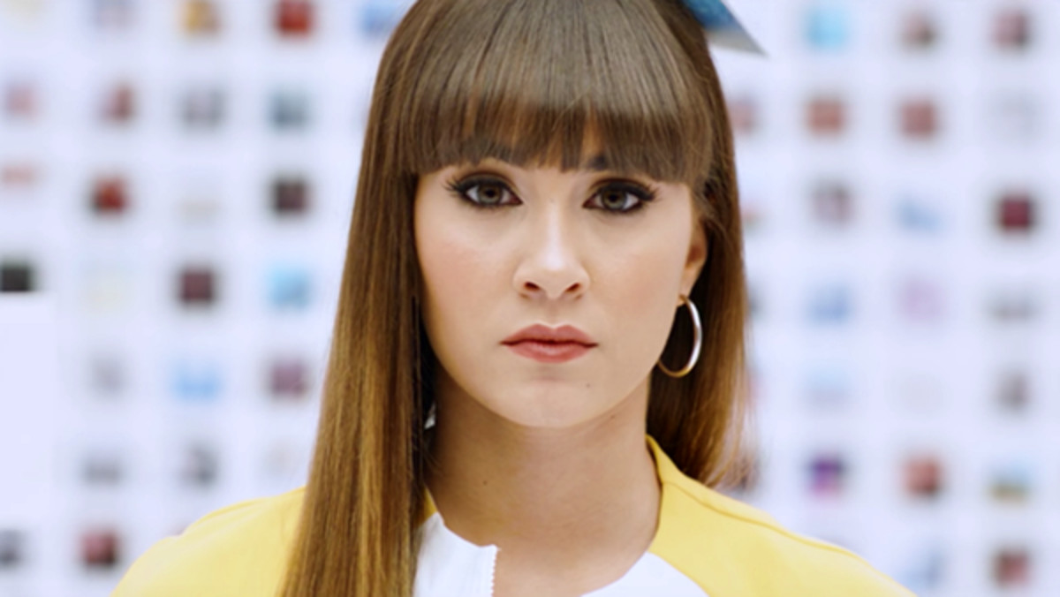
Question: how old are you currently? I’m 20 years old

Slide 11
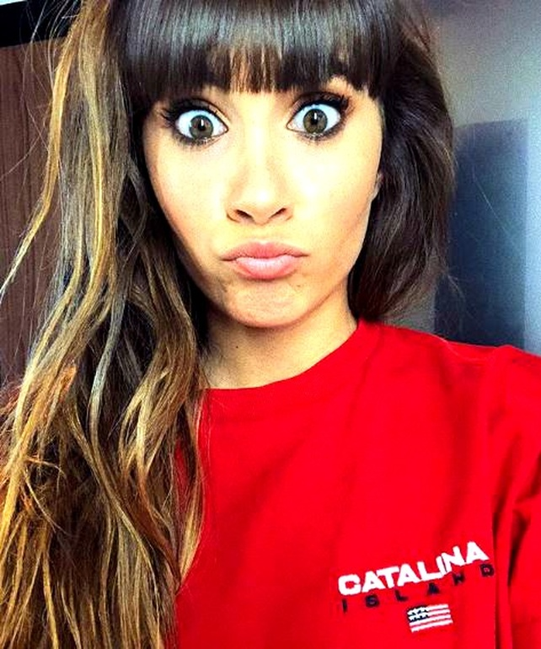
Question: why the Aitana tour was resumed?
Answere:because the COVID-19 made me canceled.

Slide 12
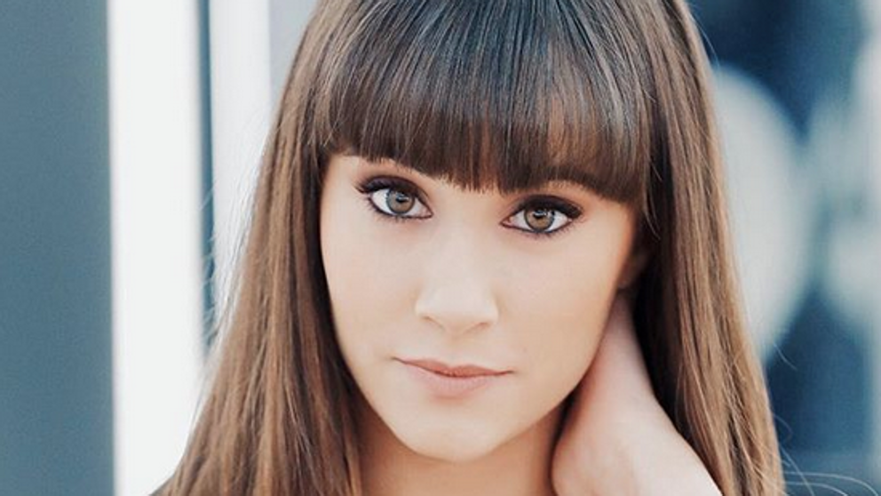
Question: what song did you play when you were twelve?
Answere: I sang we are the world.

Slide 13
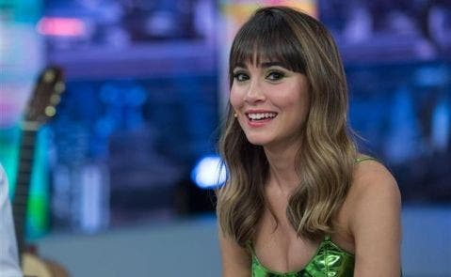
Question:when is going to be your next tour ?
Answere: if I could in may but if the COVID-19 don’t lay me in september.

Slide 14
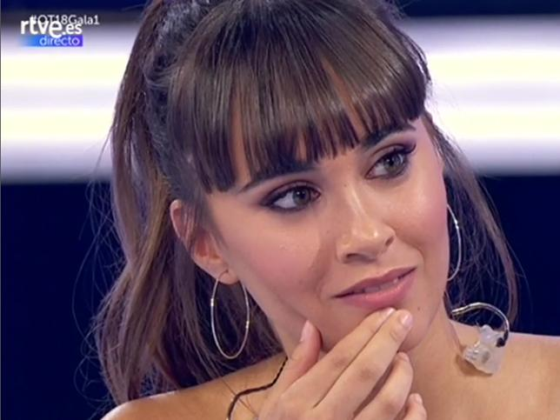
Question: Where is going to be your next tour?
Answere: in barcelona

Slide 15
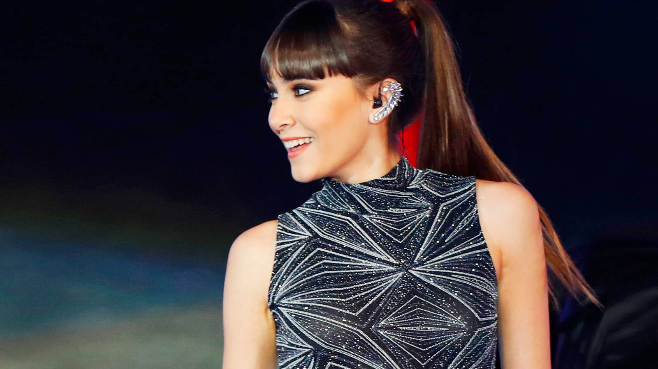
Question: in which plans are you thinking for the future?
Answere: in a new song with piso 21

Slide 16
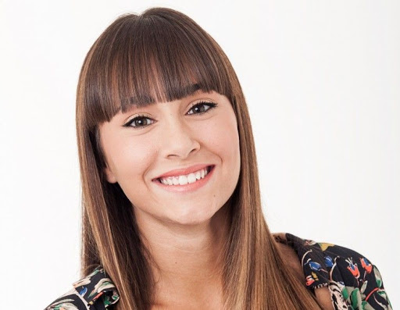
Question: why have already had a career based on art and you gave it up for the music?
Answere: Because when I was studing in Madrid I saw ot and how when I was little I love sin I enter to the casting.

Slide 17
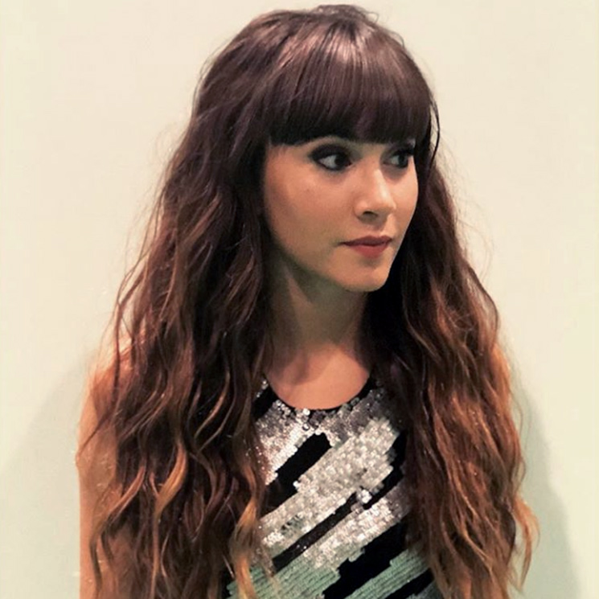
Question : in which kind of music you are in?
Answere: in pop,R&B and electropop.

Slide 18
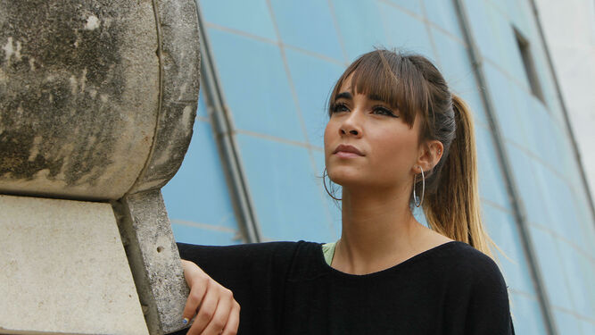
Question: why you changed your name on social media?
Answere: because never I like the “barras bajas” and all these things,like that I put a x at the end.

Slide 19
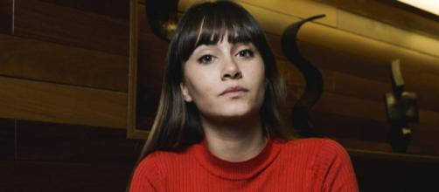
questions: Nowadays where do you live?
Answere: in Madrid

Slide 20
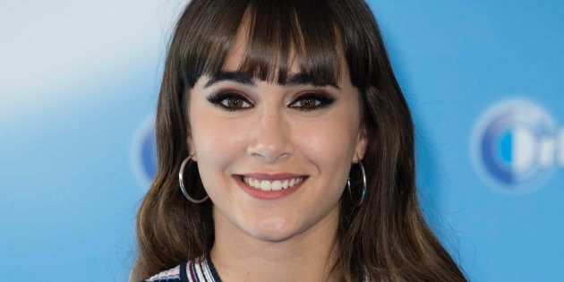
Question: which is your favorite song that you made?
Ansewere: all but now my new song enemigos because is the last song I made and I like it a lot

Slide 21
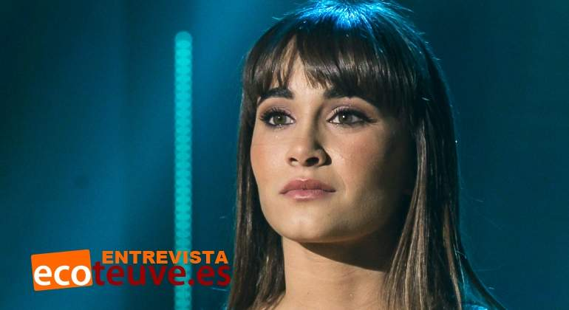
Question: How about your new song enemigos?
answeres: I like a lot and reik and me we like a lot.

Slide 22
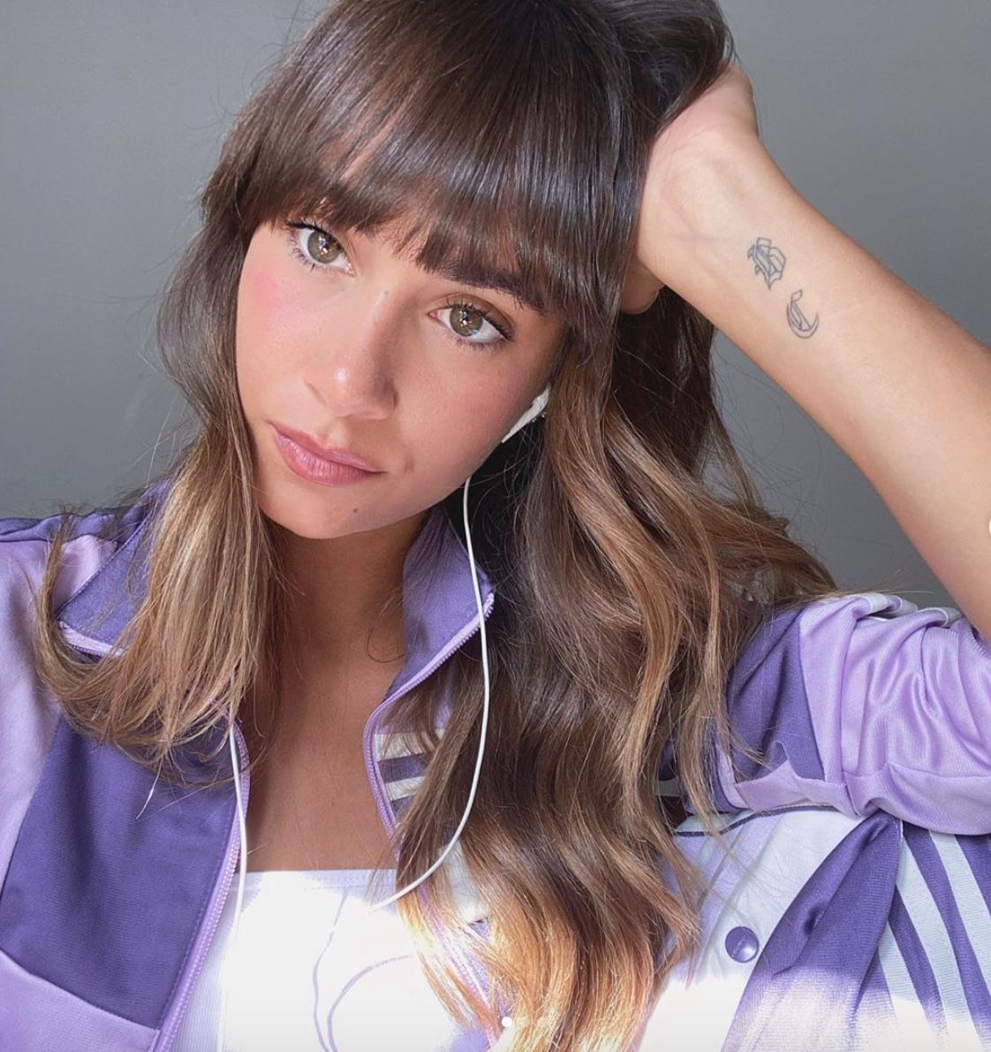
Question:how do you think your songs?
Answere:inspiring me in thing that happen to me.
Question:when you started to make versions of songs in youtube?
Answere: in 2014

Slide 23
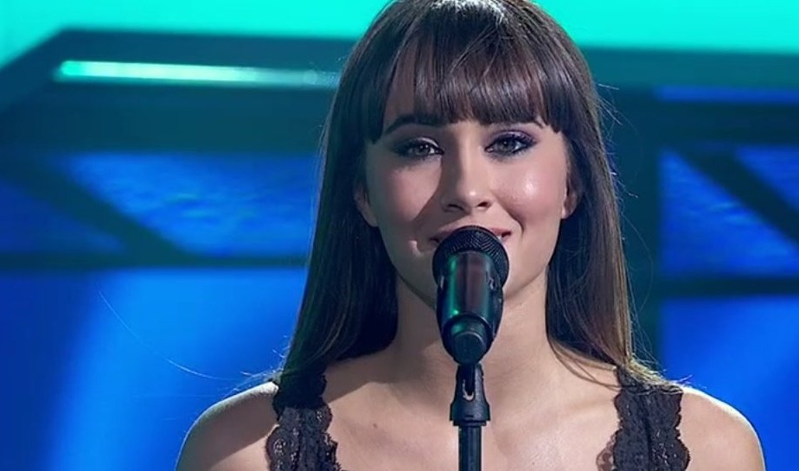

The end!

