Slide 1
Pronouns

Slide 2
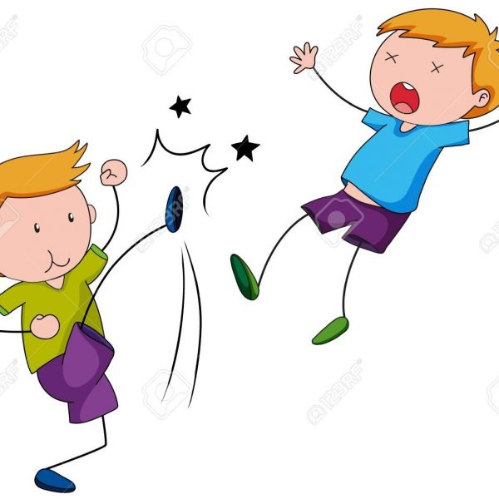
Subject or Object
Subject Pronouns – do the action
Object Pronouns – receive the action

Slide 3
Subject or Object
Object Pronouns – receive the action
Subject Pronouns – do the action

Slide 4
Subject or Object
Subject Pronouns – do the action
Object Pronouns – receive the action
Subject | Object
I | me
You | you
He | him
She | her
It | it
We | us
You | you
They | them
Steve
Jimmy

Slide 5
Subject or Object
Subject Pronouns – do the action
Object Pronouns – receive the action
Subject | Object
I | me
You | you
 | him
She | her
It | it
We | us
You | you
They | them
Steve
He
Jimmy

Slide 6
Subject or Object
Subject Pronouns – do the action
Object Pronouns – receive the action
Subject | Object
I | me
You | you
She | her
It | it
We | us
You | you
They | them
Steve
He
Jimmy
him

Slide 7
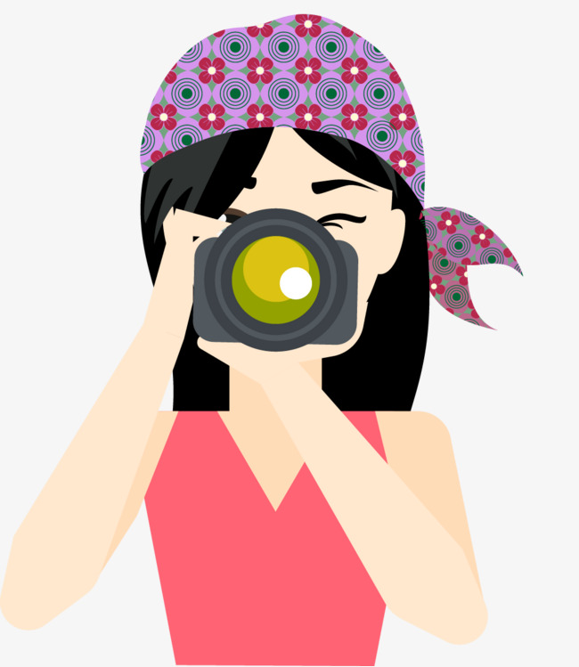
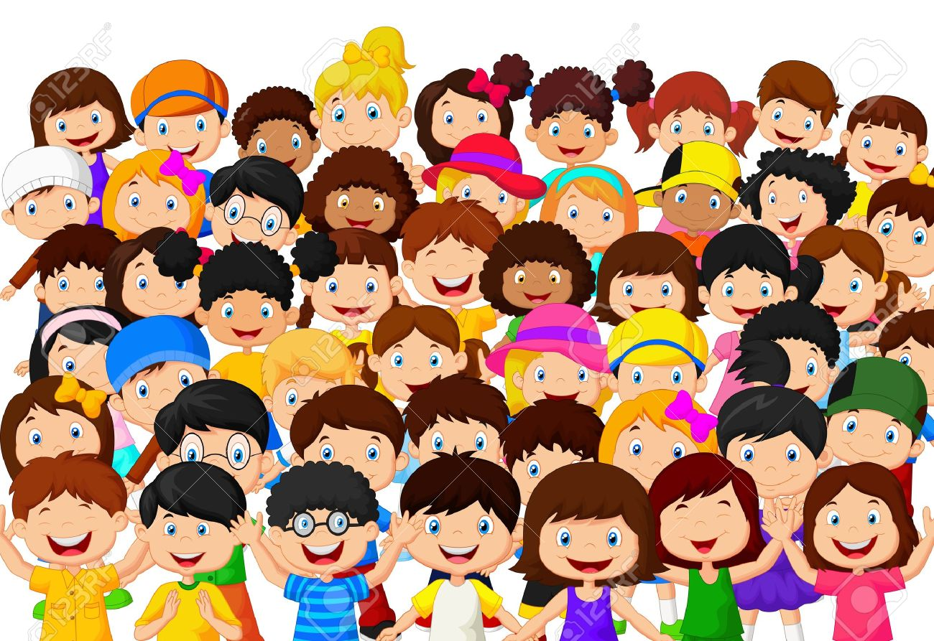
Subject or Object
Subject Pronouns – do the action
Object Pronouns – receive the action
Subject | Object
I | me
You | you
He | him
She | her
It | it
We | us
You | you
They | them
Jane
the children

Slide 8
Subject or Object
Subject Pronouns – do the action
Object Pronouns – receive the action
Subject | Object
I | me
You | you
He | him
 | her
It | it
We | us
You | you
They | them
Jane
She
the children

Slide 9
Subject or Object
Subject Pronouns – do the action
Object Pronouns – receive the action
Subject | Object
I | me
You | you
He | him
 | her
It | it
We | us
You | you
They
Jane
She
the children
them

Slide 10
Subject or Object
Subject Pronouns – do the action
Object Pronouns – receive the action
Subject | Object
I | me
You | you
He | him
 | her
It | it
We | us
You | you
They
Jane
She
them
the children

Slide 11
_____ kicked Jimmy.

Slide 12
__He__ kicked Jimmy.

Slide 13
__He__ kicked ______.

Slide 14
_He_ kicked _him_.

Slide 15
Jane took a photo of the children.

Slide 16
She took a photo of them.

